Slide 1
R 102: Practical Applications of R
R Workshop – Tech
June 27, 2023
Charlotte Looby, clooby@rti.org

Slide 2
Where can I find this PowerPoint presentation? Do I need to have R downloaded?
For doing the exercises in this workshop, it would be helpful to have this presentation downloaded on your computer.
Look for the link in Kevin’s email: https://github.com/CharlotteLoobyRTI/IFDTC_Materials/blob/main/IFDTC_presentation_RTech.pptx
Click “View raw” to download.
It’s recommended to have R or RStudio downloaded for this workshop, but it’s not necessary.
Notes:
Who has R or Rstudio downloaded?

Slide 3
Topics
Tidyverse
Importing CSVs
Formatting data
Creating summary statistics
Creating tables using kable
Creating graphs using ggplot2
De-identifying data
Notes:
Dataset is NOT REAL!

Slide 4
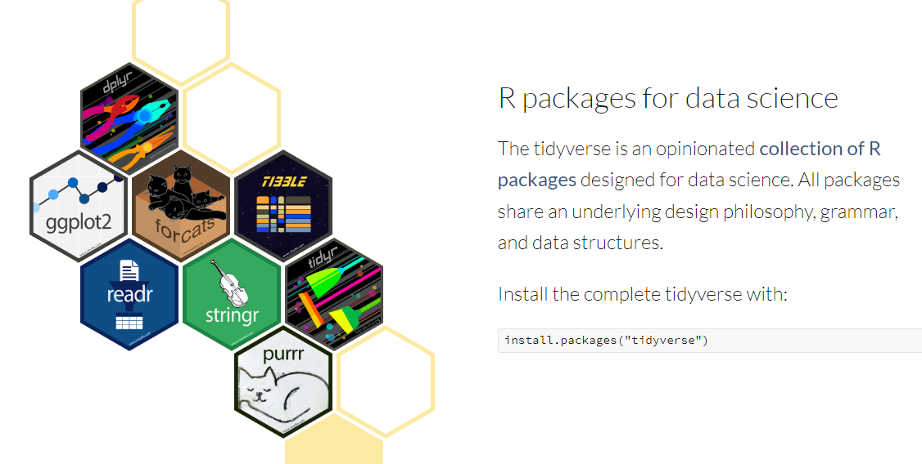
Tidyverse

Slide 5

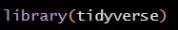
What packages will I need?
tidyverse (this contains the readr, stringr, dplyr, and ggplot2 packages we’ll use)
campfin
kableExtra
Install them like this:
Load them for use like this:
Notes:
Loading packages is what you do at the very beginning of an R script.
Rstudio, open new R script and load packages up top. Ctrl+shift+n OR file -> new file -> R script. New script in “script editor” box.

Slide 6

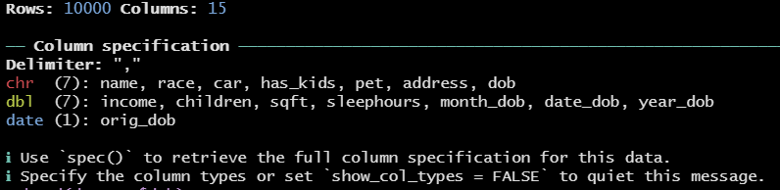
Importing CSVs
Use the read_csv function from the readr package (in tidyverse).
The console will display information about the CSV.
Notes:
Dbl means double classificiation. “Double precision floating point number”. Basically interchangeable with integer.

Slide 7
Exercise 0: Install packages and import CSV
(1) Install needed packages (if you haven’t already): tidyverse, campfin, kableExtra
(2) Import CSV of dataset we’ll use for exercises and name the data frame “dataset”.
This link is in Kevin’s email
https://raw.githubusercontent.com/CharlotteLoobyRTI/IFDTC_Materials/main/PII_toydata2.csv

Slide 8
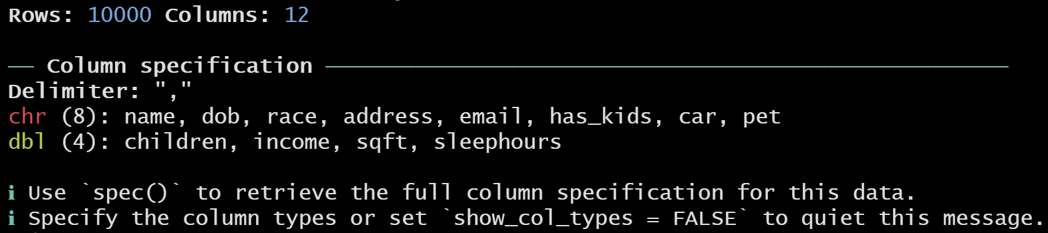
Exercise 0 results

Slide 9

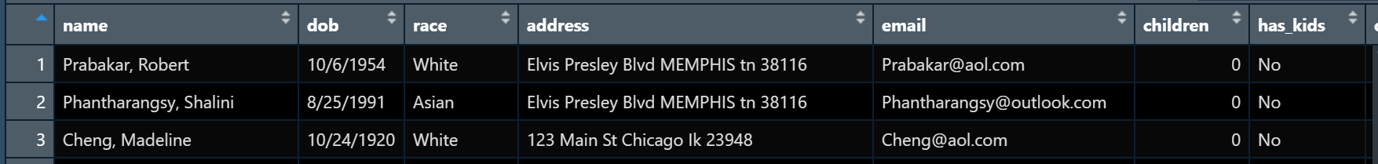
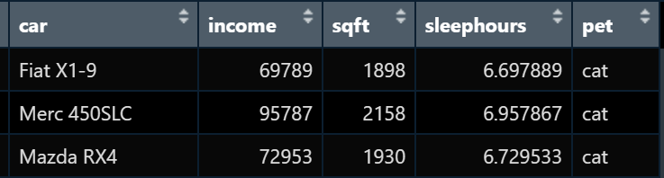
Check out your data

Slide 10


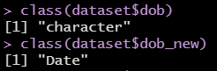
Formatting Data - Dates
Depending on the format, some dates will be read from CSV files as character. These should be converted to classification “Date”. An R “Date” variable will be in the format YYYY-MM-DD.
First, check which format it’s currently in:
Next, use the function as.Date to convert dob to Date classification in new variable dob_new
Check for correct classification.
Notes:
Tools -> global options -> code -> display -> “Rainbow parentheses”

Slide 11

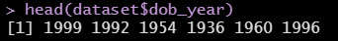



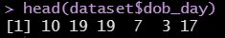
Formatting Data – Dates cont’d
Now parts of the date can be extracted for use

Slide 12



Formatting Data – Dates cont’d
We can calculate age using Sys.Date()
Divide by 365.25 days in a year
Round down and get the “floor” age

Slide 13




Formatting Data - Addresses
Standardize format of inconsistent address formats

Slide 14



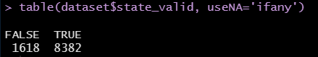
Formatting Data – Addresses Cont’d
How can we check if all addresses have a valid state?
First, extract state from the address string using the word function
Next, use the %in% function to check if the state is in the state.abb vector
Check if there are any state_valid=FALSE
Notes:
?word

Slide 15
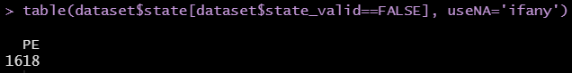

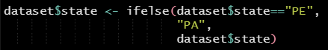
Formatting Data – Addresses Cont’d
Uh oh, there are invalid states! What are they?
What should “PE” actually be? Check out first few observations where this happens.
“PE” should actually be “PA”. Use ifelse statement to fix.

Slide 16

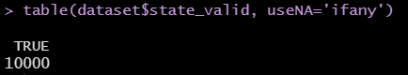
Formatting Data – Addresses Cont’d
Check that the fixes were done correctly.

Slide 17

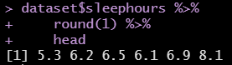
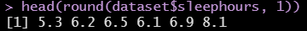
Yeah, but how would I do these things the tidyverse way?
Tidyverse coding uses pipes from the magrittr package (get it?)
Forward pipe: %>%
Coding happens left-to-right instead of inside-to-out
Inside-to-out coding: “I arrived at the mall after driving there in my car, in which I fastened my seatbelt.”
Left-to-right coding : “I fastened my seatbelt, then drove my car to the mall.”

Slide 18
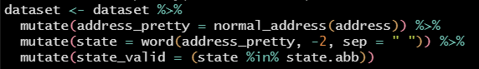
Coding the tidyverse way – formatting data using pipes
Notes:
No dollar signs needed

Slide 19
Exercise #1: Formatting Data
Format the variable “dob” to be a Date-type variable called “dob_new”.
Calculate the respondents’ current ages by creating their “floor” age.
Format the variable “address” to be a clearly formatted, “pretty” address.
Extract the state from that formatted address. Name the variable “state”.
Check for valid addresses. Fix any incorrect addresses using an ifelse statement. Check for valid addresses again to make sure it was done properly.

Slide 20

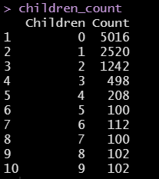
Creating Summary Statistics – Frequency Table
Create frequency table of number of children, including percentage
First, create a data.frame using the table function

Slide 21

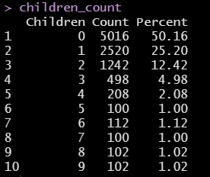
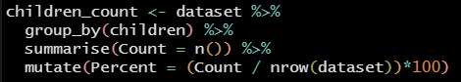
Creating Summary Statistics – Frequency Table cont’d
To add percentage, divide count by number of observations in the dataset, multiply by 100
Or do the whole thing in tidyverse:
Notes:
Can group_by multiple variables

Slide 22

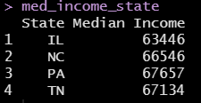
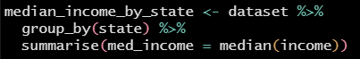
Creating Summary Statistics – Other summary data
Use aggregate function to get the median income by state
Tidyverse way:
Notes:
Statistic of a continuous variable grouped by a categorical variable

Slide 23


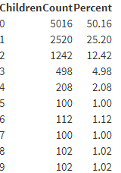
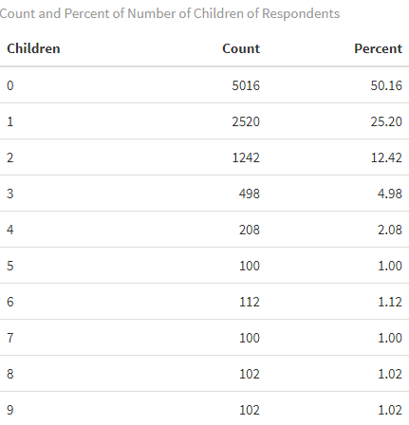
Creating Tables using kable
Create pretty version of children_count

Slide 24

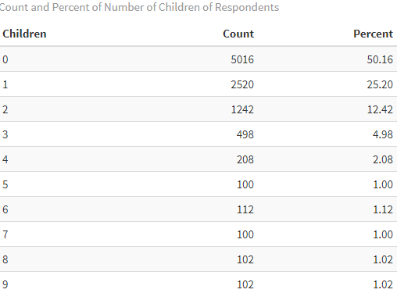
Creating Tables using kable cont’d

Slide 25
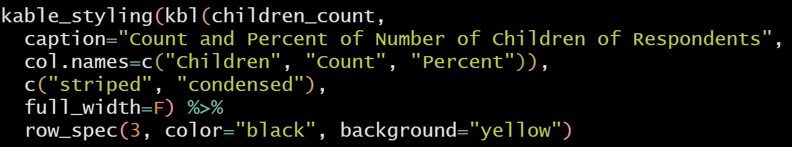
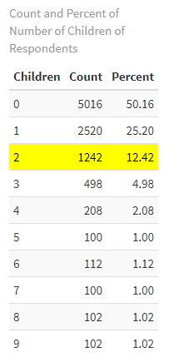
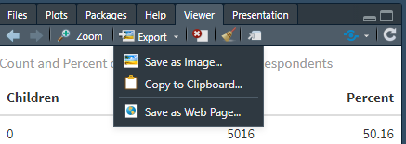
Creating Tables using kable cont’d
Save off your table in the viewer by going to “Export”:
Notes:
Viewer pane, bottom right

Slide 26
Exercise #2: Summary statistics and kable
Create a frequency table as a data.frame of how many respondents have each type of pet (pet). Include percentage.
Create a table as a data.frame showing the maximum square footage of the respondents’ homes (sqft) within groups of whether the respondents have children (has_kids). Use the function max().
Use kable to create a presentation-ready table of either of these data.frames.

Slide 27
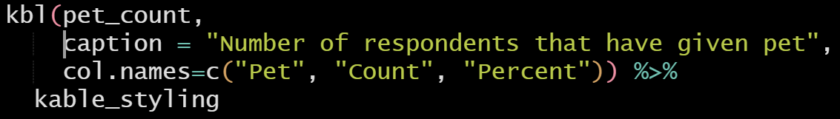
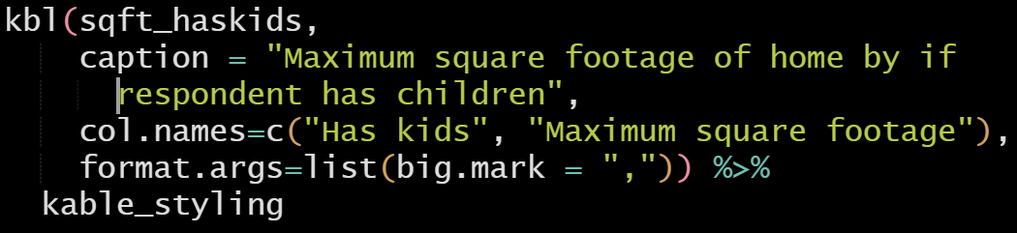
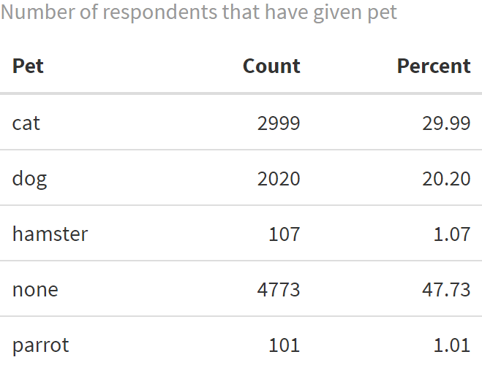
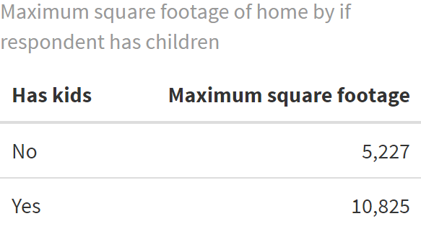
Exercise #2: Possible Solutions

Slide 28
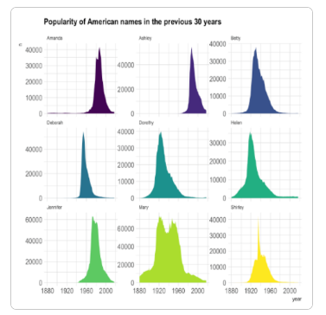
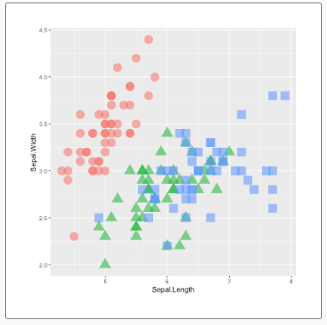
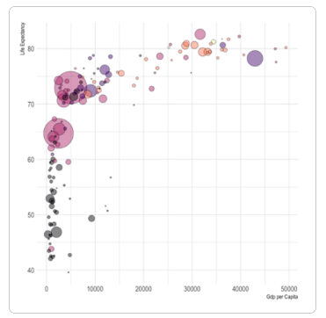
Creating Graphs using ggplot2

Slide 29
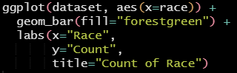
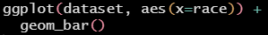
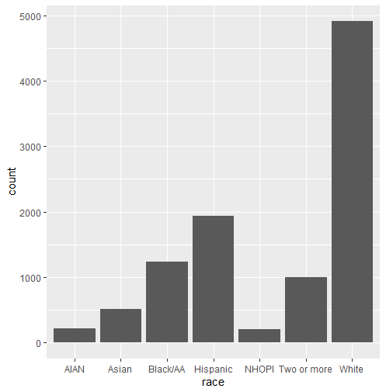
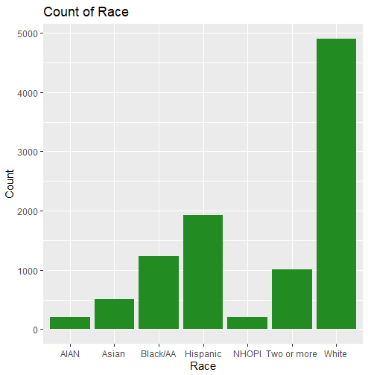
Creating Graphs using ggplot2 cont’d
Bar chart

Slide 30
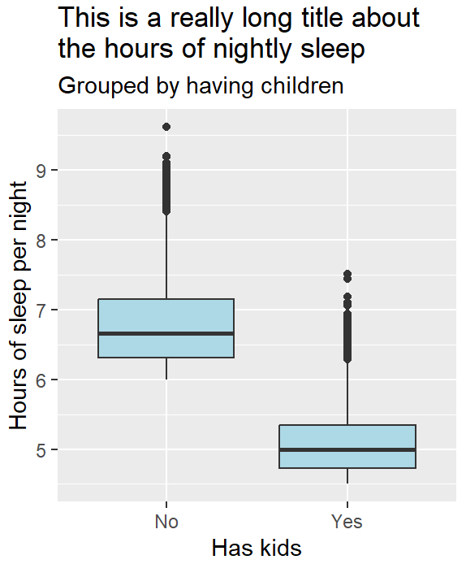
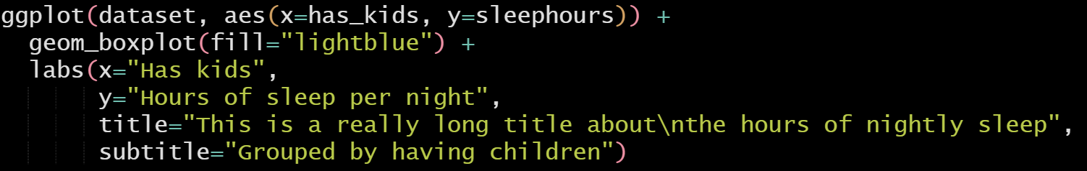
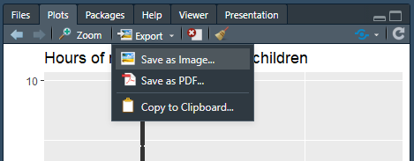
Creating Graphs using ggplot2 cont’d
Box plot with groups
Save off your graph in the viewer by going to “Export” (same as table):

Slide 31
Exercise #3: Create graphs using ggplot2
Create a bar chart of how many respondents have each type of pet (pet).
Create a box plot that groups the square footage of the respondents’ homes (sqft) by whether they have children (has_kids).

Slide 32
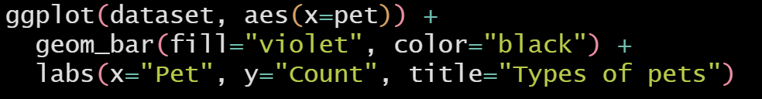
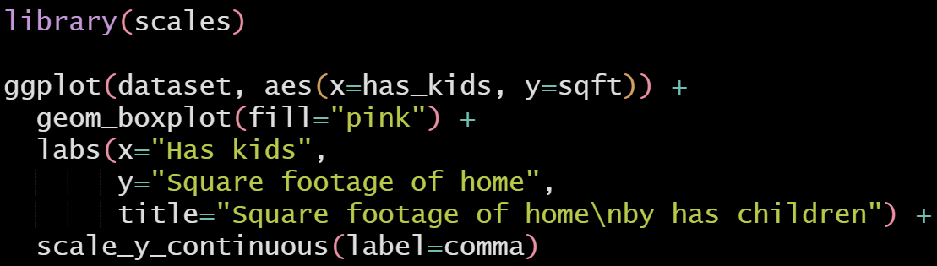
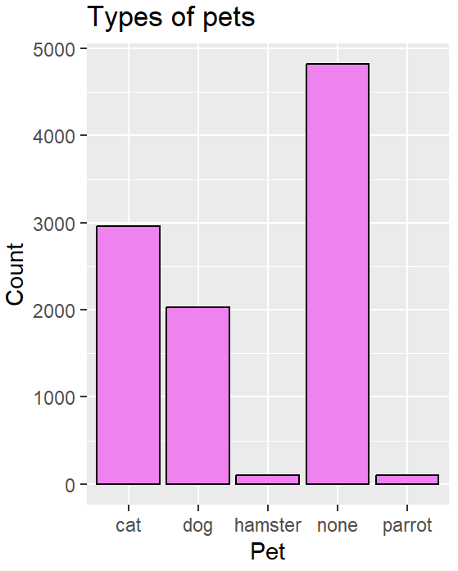
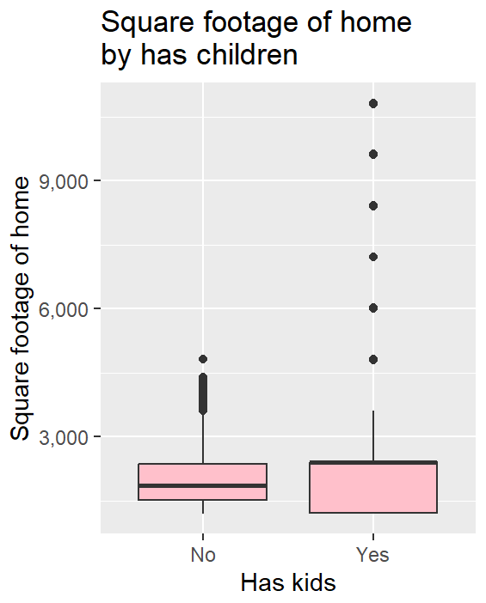
Exercise #3: Possible Solutions

Slide 33
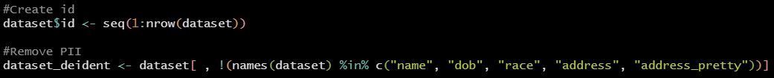

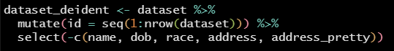

De-identifying Data
Remove any personal identifiable information (PII) using base R:
Check that the variables left are not PII
Tidyverse way!
Save it

Slide 34
Exercise #4: De-identify data
De-identify the dataset by removing variables containing PII and check variable names after.
Be sure to create an ID variable to link the PII back later if needed.

Slide 35
Resources
tidyverse: https://www.tidyverse.org/packages/
This includes information on the other packages that we’ve used within tidyverse (ggplot2, stringr, readr, and dplyr)
kableExtra: https://cran.r-project.org/web/packages/kableExtra/vignettes/awesome_table_in_html.html
Beautiful graphs for inspiration: https://r-graph-gallery.com/
All the R colors neatly displayed: http://www.stat.columbia.edu/~tzheng/files/Rcolor.pdf
Next step: Rmarkdown!

Slide 36

Thank you
Contact: Charlotte Looby | email: clooby@rti.org

